Slide 1


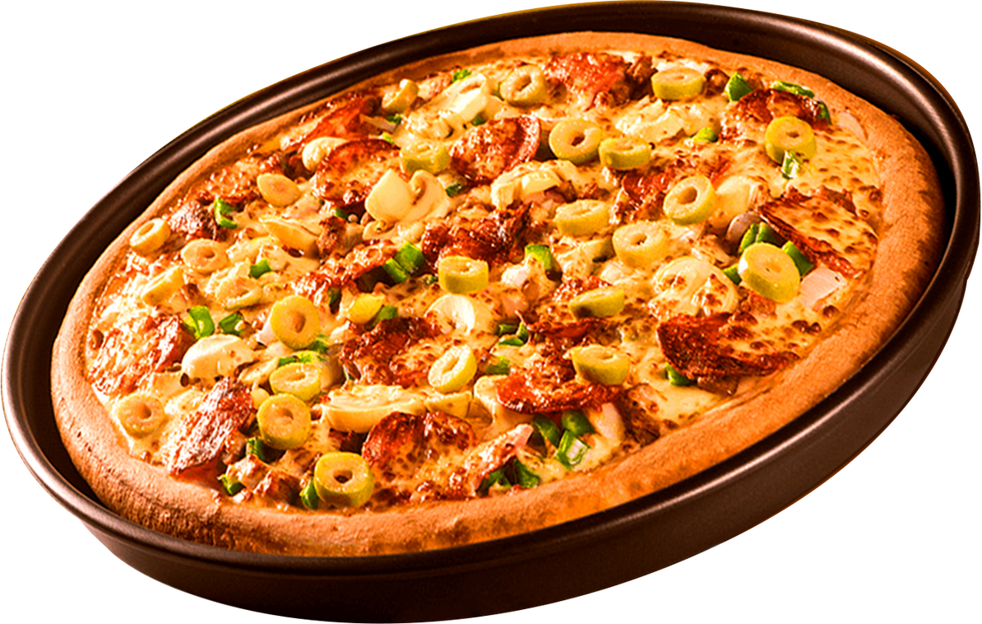


Home
Pizza Hut Sales Analysis
By varalaxmi

Slide 2

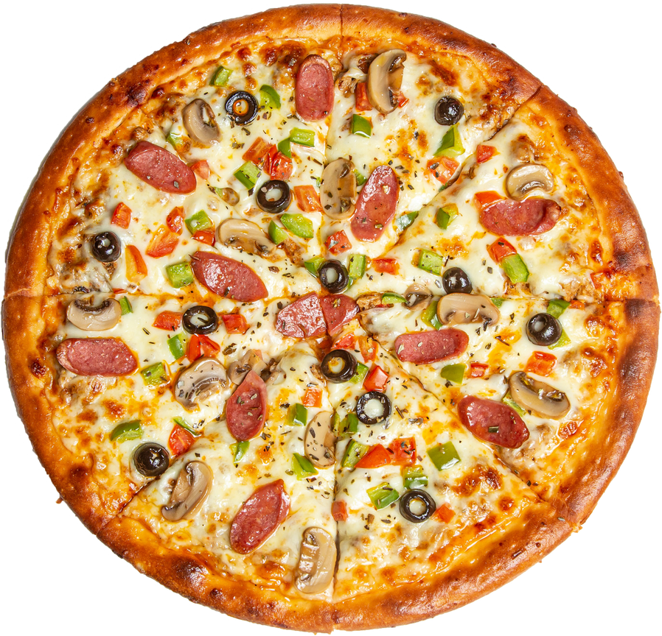
Contact
INTRODUCTION
This pizza Hut sales analysis project aims to provide a comprehensive understanding of PizzaHut’s sales performance, focusing on identifying key trends, popular products, and areas for improvement.

Slide 3

PROBLEM STATEMENT
Identifying and Analyzing trends in pizza Hut’s sales performance over time to determine seasonal fluctuations , peak sales periods and identifying peak order times during the day and week to optimize staffing, kitchen operations and delivery logistics .
develop predictive model to forecast future sales based on historical data .

Slide 4
DATASET DESCRIPTION
About
Contact
Dataset Name: pizza Hut sales Data. This Dataset provides detailed transactional data related to the sales performance of a pizza Hut outlet or multiple branches. this dataset is intended to support business insights, customer behavior analysis and strategic decision making.
KEY FEATURES:
Order ID, Date/time, customer ID, category, Quantity, Price, Menu item, order type, Total sales...

Slide 5
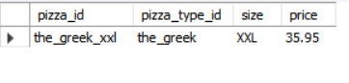
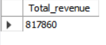
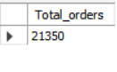
BASIC ANALYSIS
Contact
Most expensive pizza size
2. Total Revenue
Total Orders Count

Slide 6
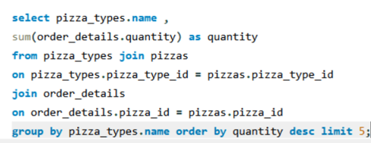
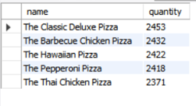
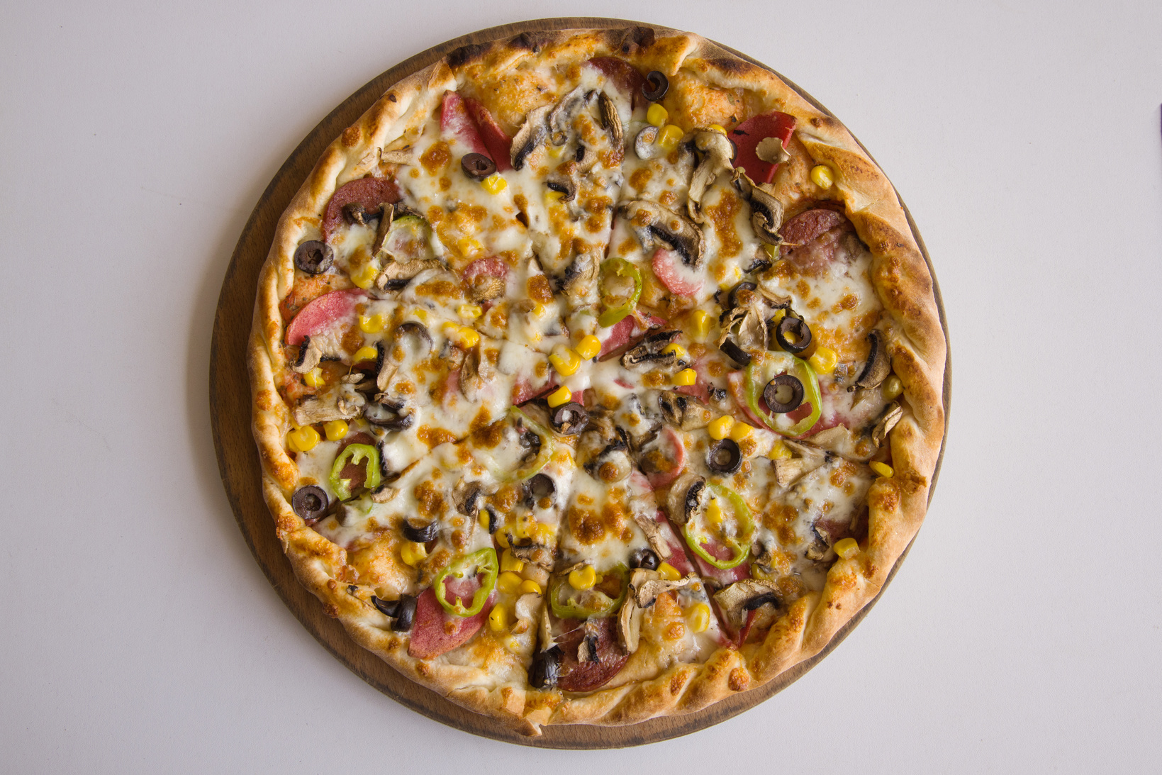
TOP 5 POPULAR PIZZAS
Home
About
Contact

Slide 7
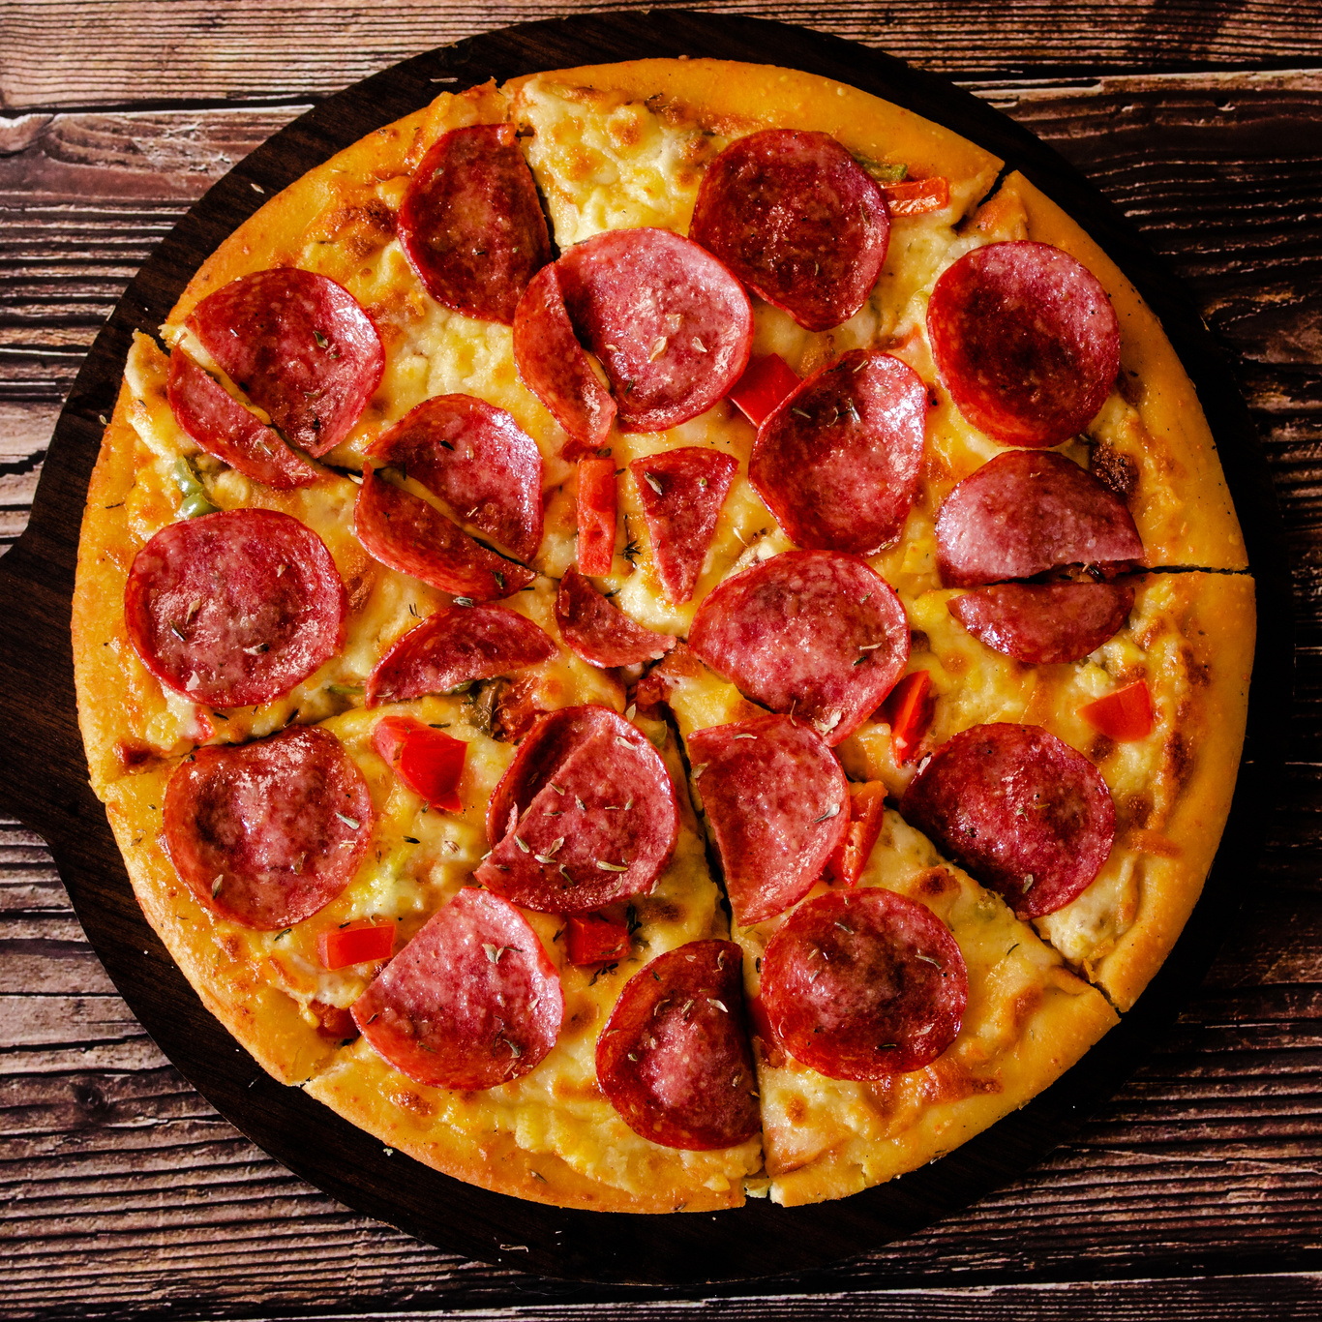
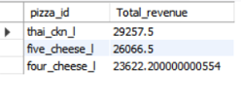
Top 3 pizzas based on Revenue
QUERY :
select order_details.pizza_id, sum(order_details.Quantity*pizzas.price) as 'Total_revenue'
from order_details join pizzas
on order_details.pizza_id = pizzas.pizza_id
group by order_details.pizza_id
order by Total_revenue desc
limit 3;
Home
About
Contact
OUTPUT :

Slide 8
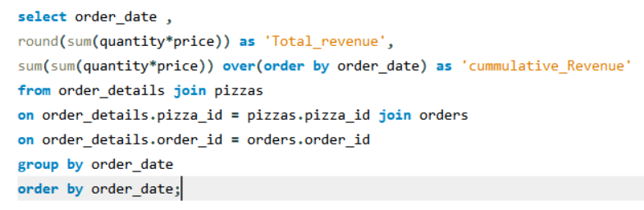

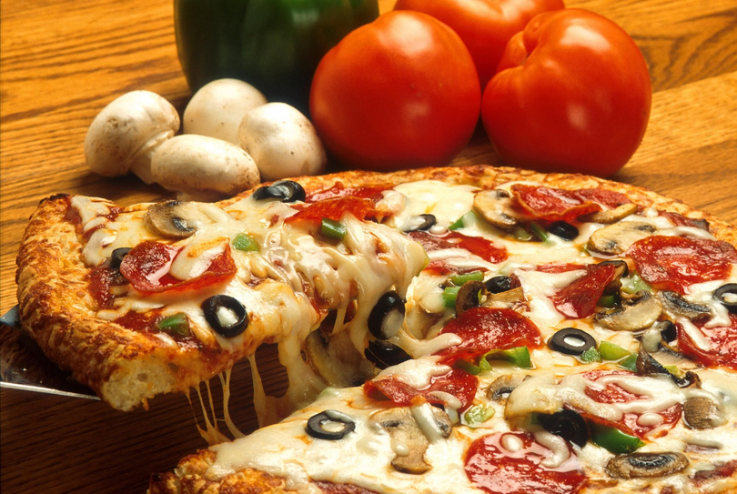
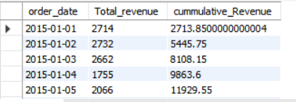
CUMMULATIVE REVENUE OVER TIME
Home
About
Contact

Slide 9
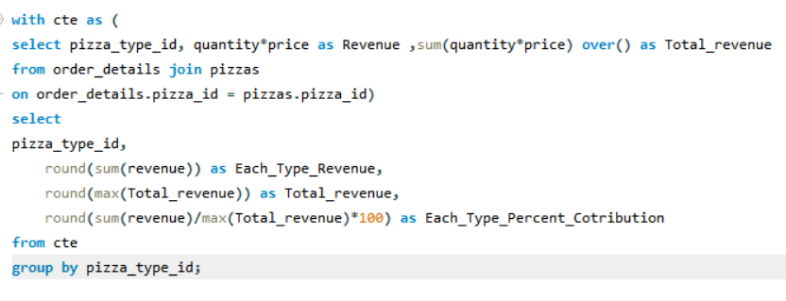
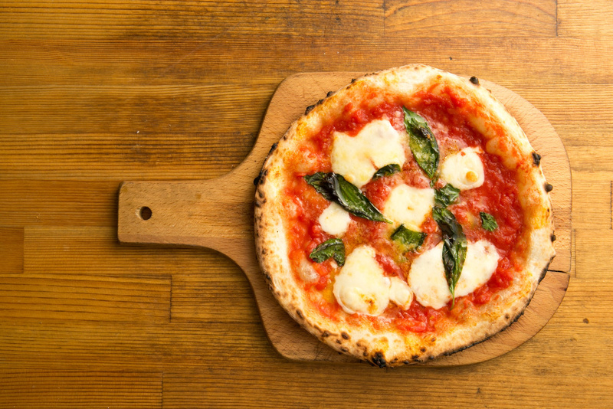
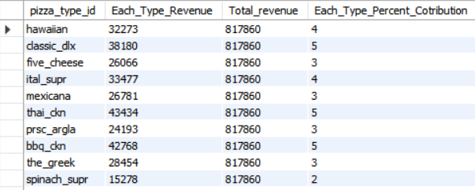
Revenue contribution by pizza type
Home
About
Contact

Slide 10
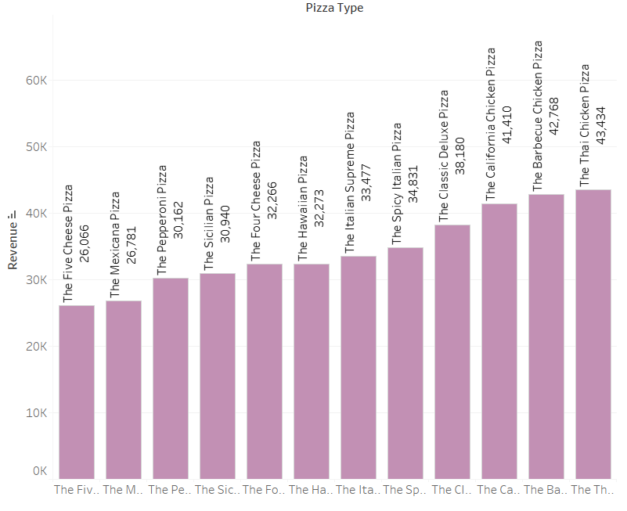
TABLEAU
Each pizza Type Revenue

Slide 11
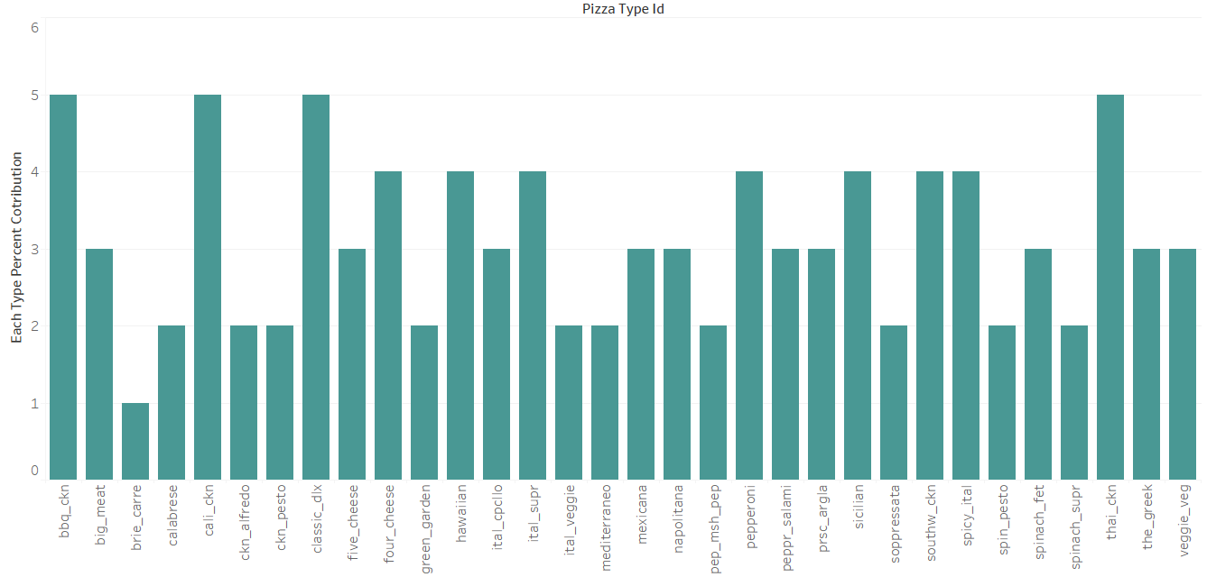
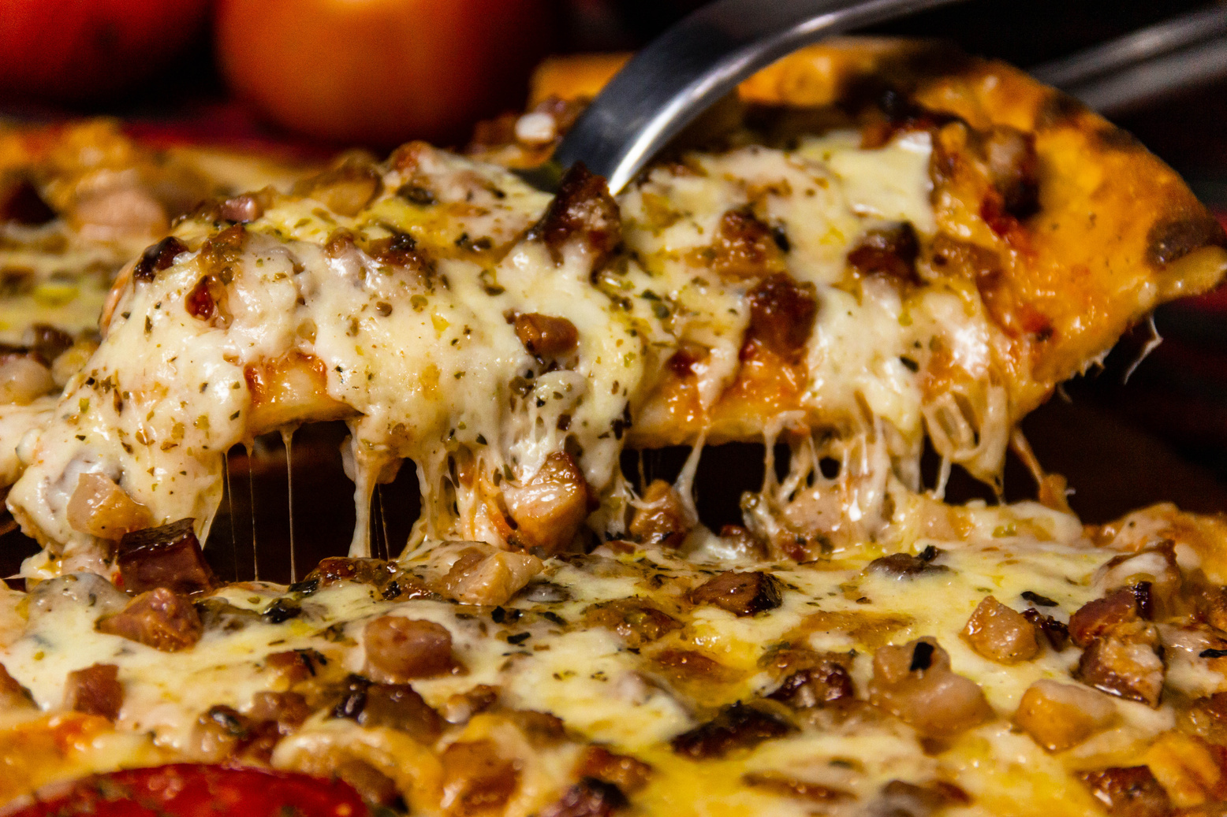
EACH PIZZA TYPE PERCENTAGE CONTRIBUTION
About
Contact

Slide 12
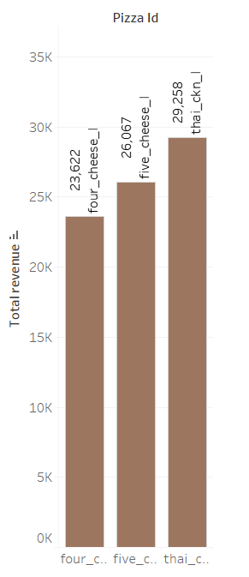
Top 3 pizzas based on Revenue

Slide 13
About
Contact
INSIGHTS
Total orders is 21,350 and Total Revenue is 817,860
peak hour orders between 12PM-2PM and 5PM-6PM
The most popular pizza size is large size pizzas
Remaining pizza sizes are low in revenue
The most expensive pizza is Greek pizza XXL
classic pizzas contributed the highest revenue

Slide 14
RECOMMENDATIONS
About
Contact
To increase sales and build a successful pizza business, focus on offering excellent quality.
creating strong online presence, and leveraging marketing strategies to reach a wider audience.
consider offering customizable pizzas.
engaging with local community through events and partnerships.
create unique specialty pizzas with interesting ingredients combinations to keep customers coming back.

Slide 15
Mail Id
varam1472@gmail.com
THANK YOU
FOR ATTENTION
PIZZA SALES ANALYSIS PRESENTATION

